Slide 1
Project Presentation of Advanced Full Stack(AFS)
On
Interview Prep- Interview Preparation Platform
Submitted By:- Garvit Goyal - 2210991565
Supervised By:-
Ms. Preenu Mittan
Department of Computer Science and Engineering,
Chitkara University, Punjab

Slide 2
Contents
Introduction
Problem Statement
Objective
Key Features
Technology Stack
System Architecture
Project Snapshots
Conclusion
Future Scope
References/Links used

Slide 3
Introduction
InterviewPrep is a comprehensive platform designed to support Full Stack Development candidates in their job preparation journey. It offers more than just mock interviews, providing features like profile creation, resume uploads, job applications.
With realistic interview simulations, system design challenges, behavioral assessments, and expert feedback, InterviewPrep helps candidates sharpen their skills, build confidence, and stay industry-ready. Whether you're preparing for coding rounds or improving your communication, InterviewPrep bridges the gap between learning and real-world hiring.

Slide 4
Problem Statement
Preparing for technical interviews, especially for Full Stack Development, can be challenging due to a lack of structured practice, real-time feedback, and interview simulations.
Candidates often struggle with:
Limited Mock Interview Practice: Absence of realistic interview simulations.
No Structured Performance Tracking: Difficulty in identifying strengths and weaknesses.
Ineffective Feedback Mechanism: Generic or delayed feedback that doesn’t aid skill improvement
InterviewPrep addresses these challenges by offering a structured and interactive approach to technical interview preparation..

Slide 5
Objective
InterviewPrep is designed to empower Full Stack Developer candidates by offering a structured, interactive, and effective mock interview experience. The platform enables users to :
Simulate Real Interviews: Schedule and take part in live, text-based, or video mock interviews guided by industry mentors.
Get Personalized Feedback: Receive detailed, actionable insights to refine both technical problem-solving and behavioral skills.
Monitor Your Growth: Keep track of your progress with a personalized profile, resume uploads, and performance analytics.
Be Part of a Community: Join discussions, ask questions, and learn from fellow candidates in an interactive forum.
Sharpen Communication Skills: Use Speech-to-Text (SST) technology to analyze and improve spoken responses in interviews.
Experience Secure & Seamless Access: With role-based access control and encrypted data storage, your information stays safe and accessible.

Slide 6
Key Features
Secure Authentication & Role Management: Login safely with JWT authentication and access role-based features tailored for Candidates and Interviewers.
Mock Interviews: Schedule mock interview sessions to refine your skills.
Comprehensive Profile Management: Build a professional profile, upload your resume, and apply for jobs seamlessly.
Robust Security & Scalability: Enjoy a smooth experience with end-to-end encryption and a highly scalable backend for optimal performance..
Community Forum: A dedicated space where users can post questions, share knowledge, and engage in discussions related to job preparation, interviews, and career guidance.
Visual Analytics with Charts: Interactive charts provide visual insights into a candidate’s job application journey.

Slide 7
Technology Stack
MongoDB: A powerful NoSQL database that stores user profiles, job listings, interview questions, schedules, and other crucial data efficiently.
Express.js: A lightweight yet robust backend framework that seamlessly manages API requests and bridges the frontend with the database
React.js: A dynamic and responsive frontend library that delivers a smooth, interactive user experience.
Node.js: A high-performance, scalable runtime environment that powers the backend, ensuring seamless communication between all components.

Slide 8
System Architecture
Frontend: Built with React.js and Vite for lightning-fast performance, styled using Tailwind CSS to ensure a sleek and modern UI.
Backend: Powered by Node.js and Express.js, efficiently managing API requests, authentication, logging, and error handling.
Database: Utilizes MongoDB with Mongoose for structured NoSQL storage of user data, job profiles, and community discussions.
Security: Implements Argon2 for secure password hashing, JWT/OAuth for authentication, and role-based access control for restricted permissions.

Slide 9
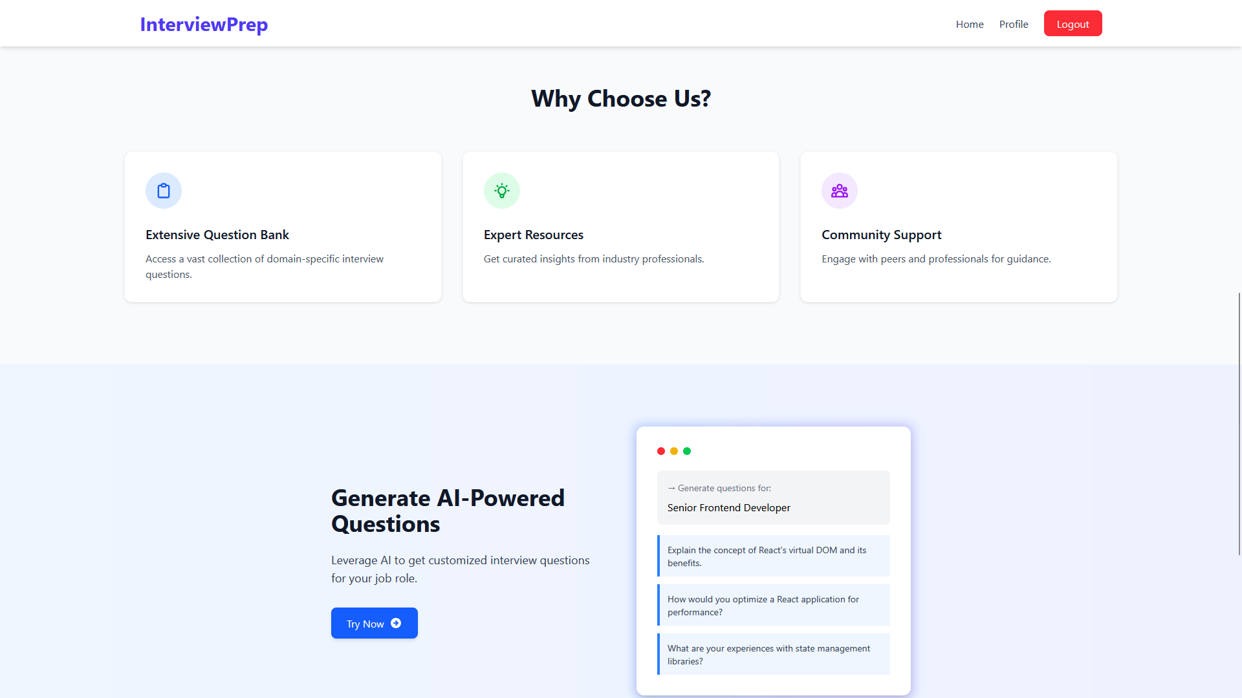
Project Snapshots

Slide 10
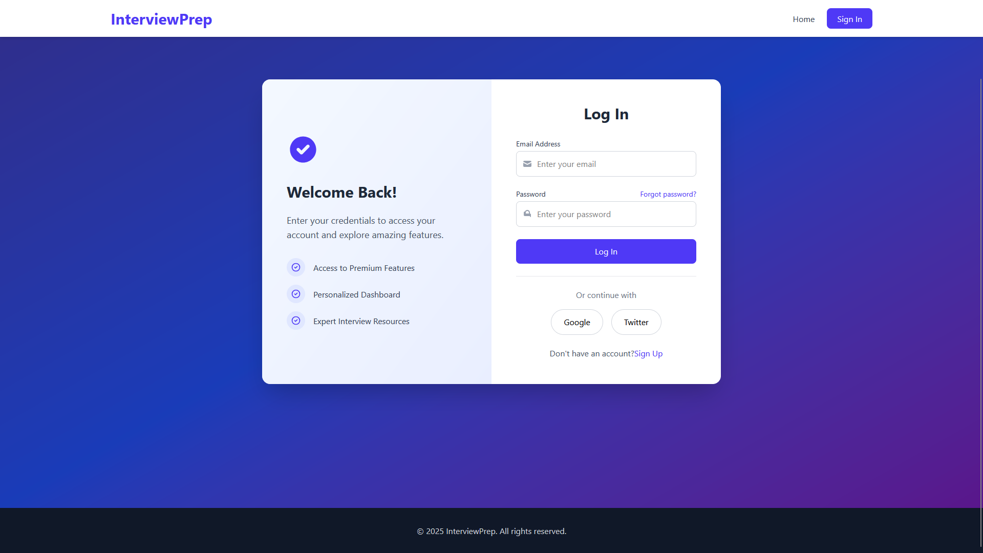
Project Snapshots

Slide 11
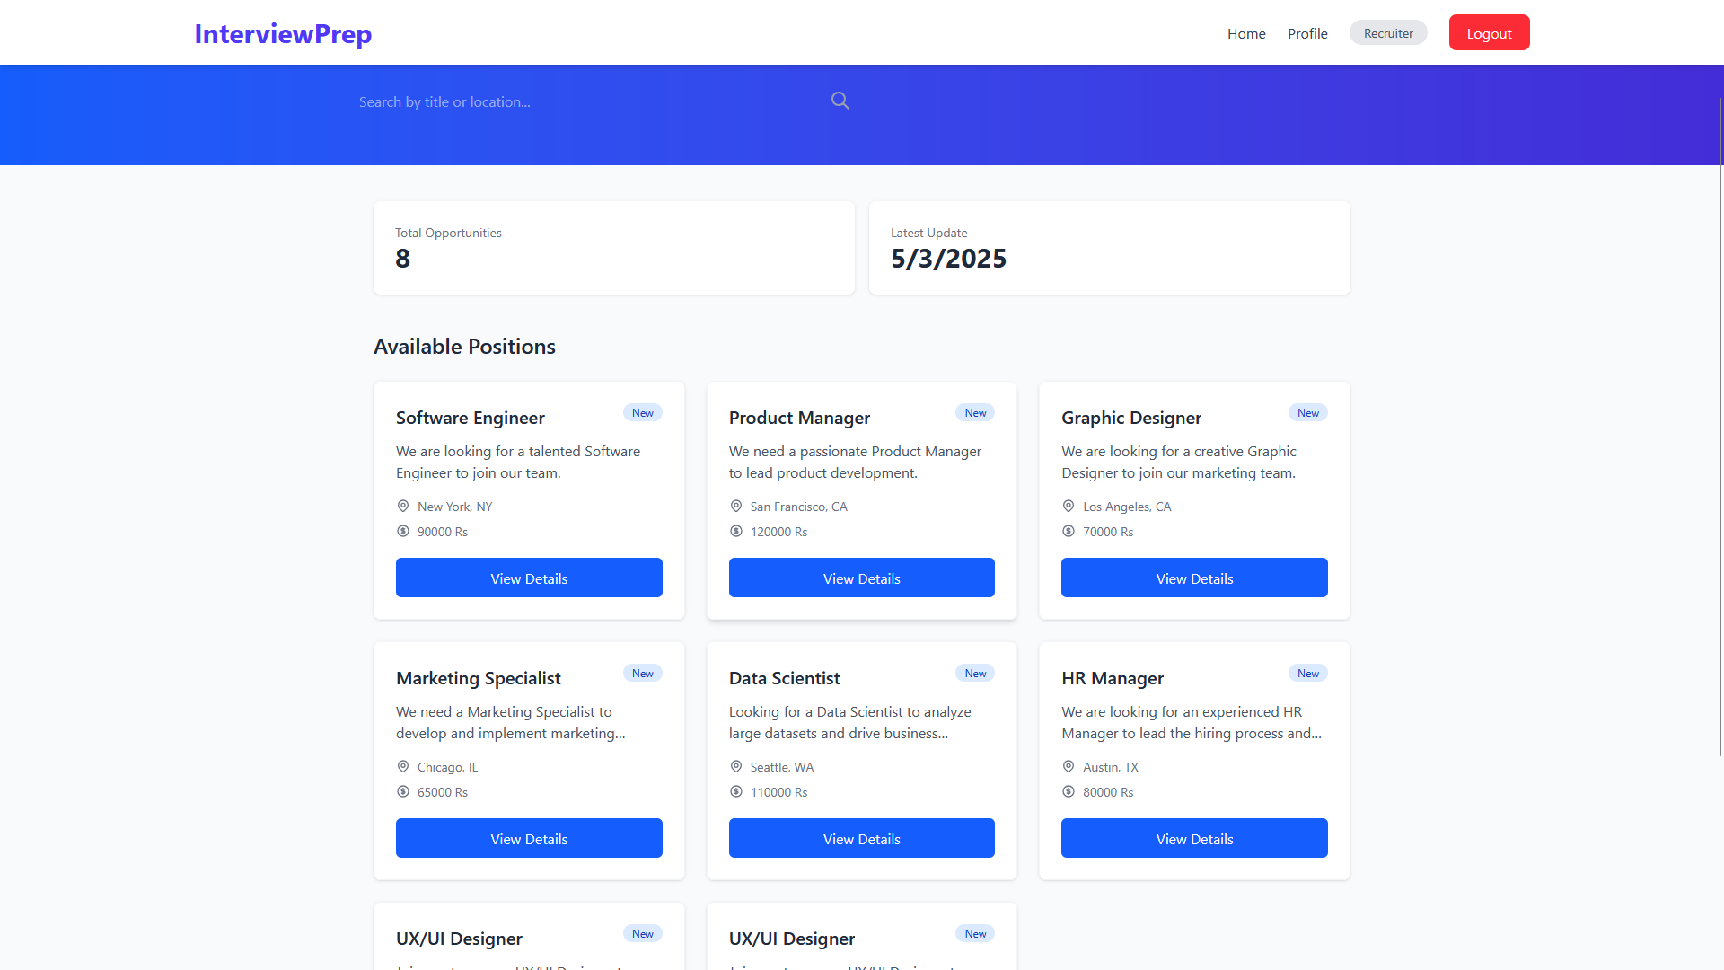
Project Snapshots

Slide 12
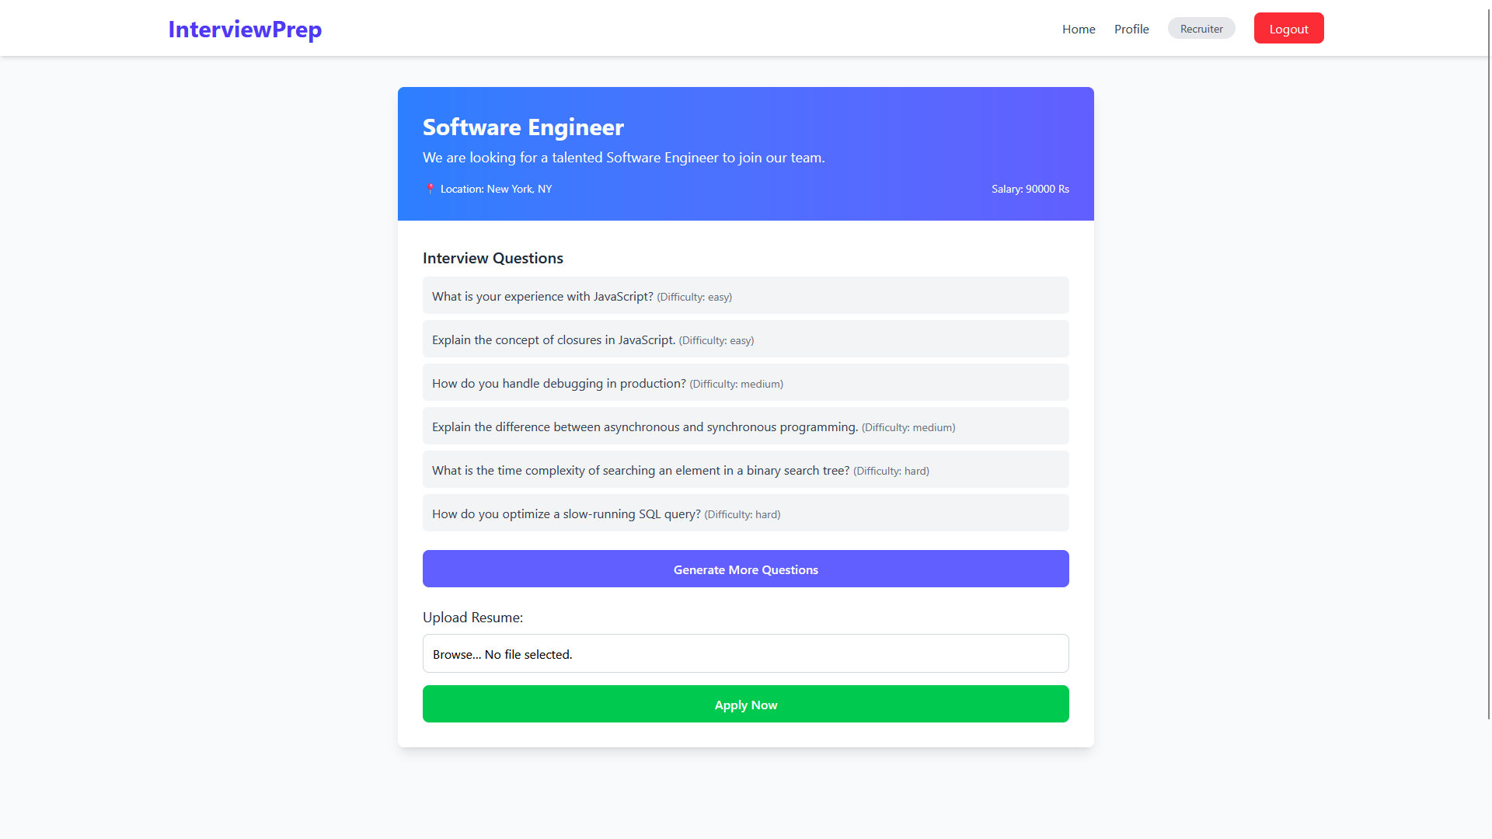
Project Snapshots

Slide 13
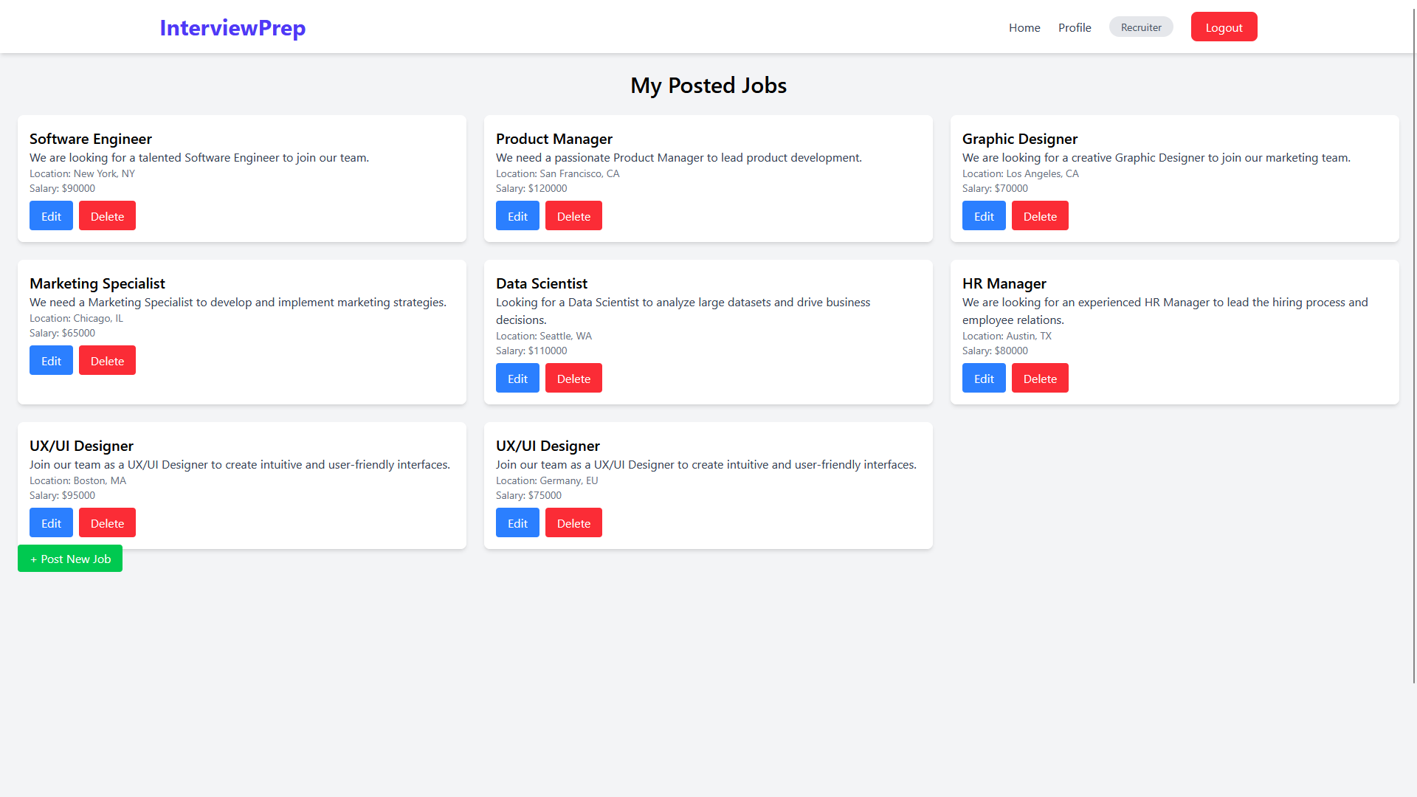
Project Snapshots

Slide 14
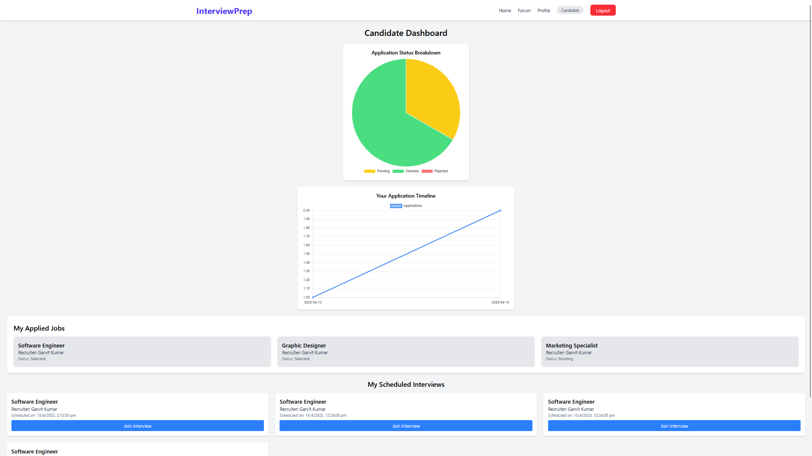
Project Snapshots

Slide 15
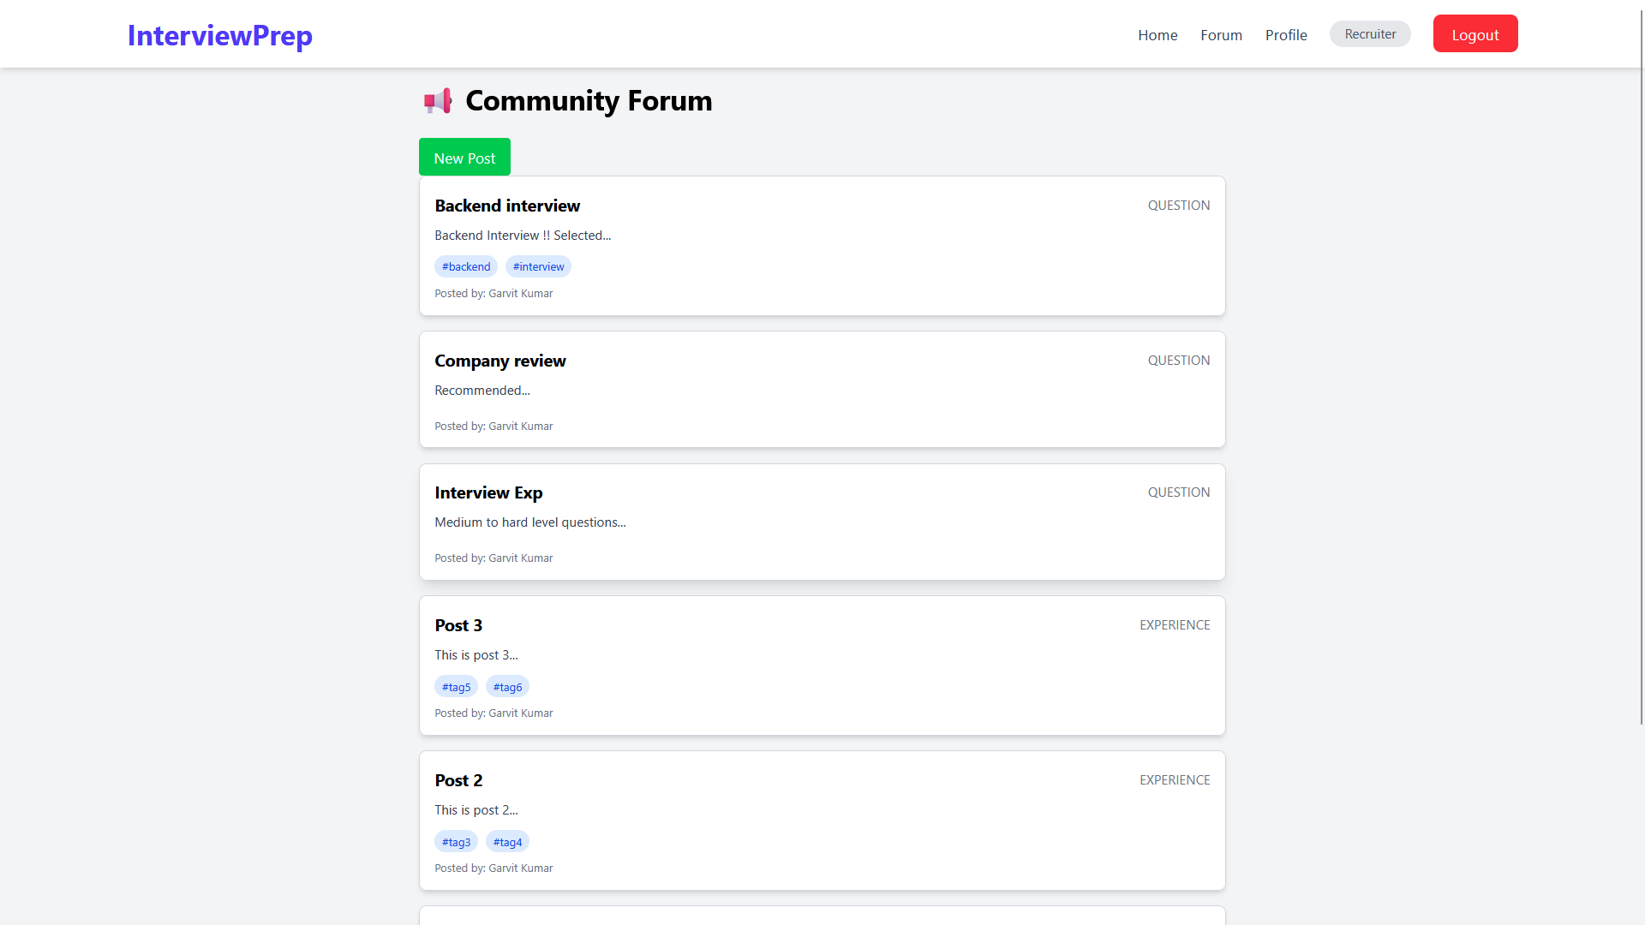
Project Snapshots

Slide 16
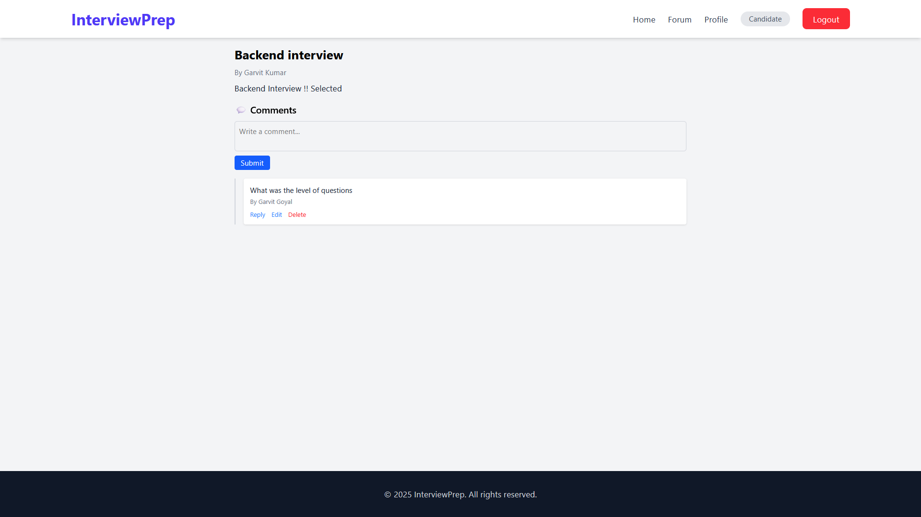
Project Snapshots

Slide 17
Conclusion
InterviewPrep is designed to help Full Stack Developers ace technical interviews with mock simulations, real-time feedback, and structured practice.
Mock Interviews: Schedule text-based or video interviews with experienced mentors and receive expert insights.
Profile Management: Build your profile, upload resumes, and track progress using an advanced analytics dashboard..
Speech-to-Text (SST): Transcribe spoken responses into text for deeper analysis and improvement
Secure & Scalable: Ensures role-based access, encrypted data protection, and a high-performance backend for a smooth experience.

Slide 18
Future Scope
Mock Interview Scheduling: Users can book live mock interviews with mentors
Multiple Interview Formats : Choose between text-based or video mock interviews for a flexible experience.
Video Recording & Feedback: Soon, users will be able to record their interviews and receive expert insights.
Certification & Badges: Showcase your progress by unlocking certificates and achievement badges.
Performance Tracking: Use the Analytics Board to monitor your strengths, weaknesses, and overall growth.

Slide 19
References
MongoDB Documentation – MongoDB, Inc. (2023).
Official MongoDB Documentation.
Express.js Documentation – Express.js Foundation. (2023). Express Framework for Node.js.
React Documentation – React Team. (2023).
React Library for Building User Interfaces.
Node.js Documentation – OpenJS Foundation. (2023).
Node.js Runtime Environment.

Slide 20
Thank You

